Slide 1
Scheduled Task - Design Pattern
By: Taylor D. Williams

Slide 2
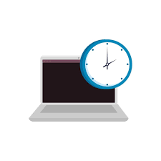
Intent
What is a Scheduled Task Design Pattern?
A type of software design pattern that uses real-time systems
Not to be confused with the Scheduler pattern!
A user can create a task scheduler reliant on the current time of their system
Overall, the pattern ensures that desired operations are performed at certain points in the future

Slide 3
Motivation
Real time systems find it necessary to have tasks done at specific times, and implementing a system using a scheduled task pattern is one of the simplest approaches in doing so.
A scheduler pattern would delay access to a resource until absolutely necessary whereas with a scheduled task pattern a task’s execution is delayed until a determined time

Slide 4
Structure
Real time scheduled tasks mainly consists of three parts:
The task itself
The jobs that schedule the task: when the task will run and for how long
The job registry that executes the task
Usually, systems that utilize the scheduled task pattern are implemented using cron on Linux servers

Slide 5
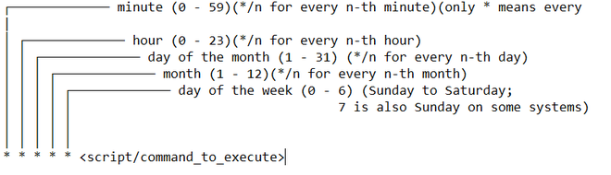
Structure cont.
This is the common configuration syntax regarding scheduling:

Slide 6
Structure cont.
A real time scheduler is designed to provide real-time guarantees
So once a task is scheduled a certain amount of time, if a user asks to run one more task it will decide what action to take based on the load it is currently carrying
If it cannot guarantee that all task can continue running at their desired rates then it will refuse another task being added
This mainly applies for when the user wants to run longer tasks, and is associated with the RMA (rate monotonic algorithm): a procedure for assigning fixed priorities to tasks
Assign the priority of each task according to its period, so that the shorter the period the higher the priority

Slide 7
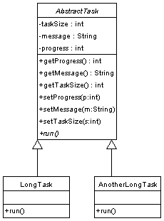
Basic UML Diagram for Task Pattern
An overall class for the tasks, that contains the methods:
That schedule the tasks, set time in which they will run.
And the size of the tasks, how long the task will run
And every task, that extends the main class and overrides the run method that other objects call to start the tasks

Slide 8
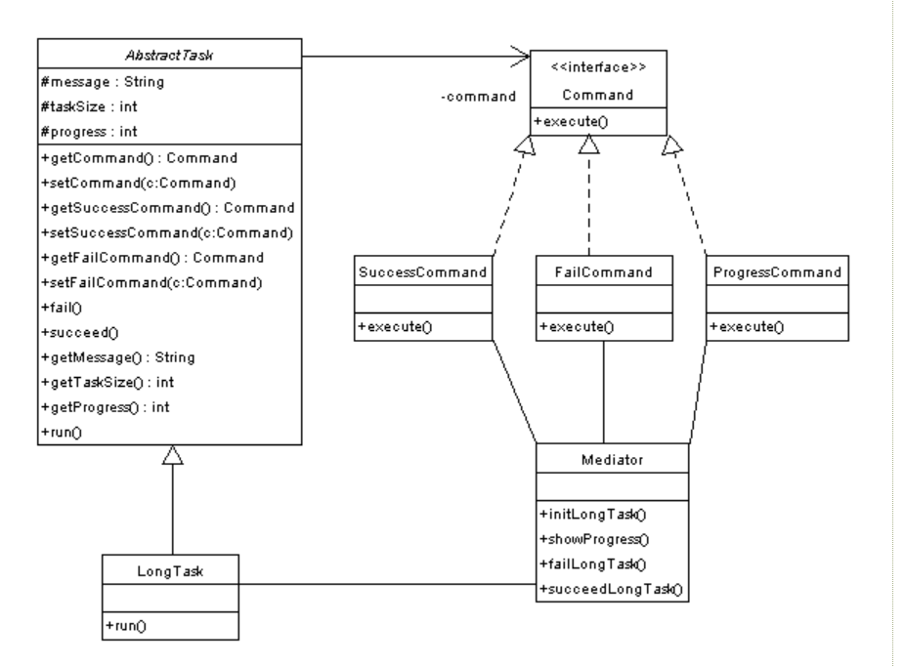
Advanced UML diagram for Task Pattern
Includes an interface that displays commands to the user
A mediator
that tracks the status of all the tasks, informing a user if the task is:
currently running,
was successful,
or failed

Slide 9
Consequences
There are some common issues that can happen when implementing scheduled task design patterns:
When having tasks running concurrently, an OS can find its processes becoming slower and slower
When implementing with cron, user’s should not expose their cronjobs to the internet
Not all tasks the user wants done in a given time frame can possibly be achieved depending on priority or if the scheduler implemented can guarantee the task’s execution

Slide 10
Known Uses
Scheduled tasks are used in many applications today, some common examples of which include:
Apps that set alarms or reminders
The option to send an email at a specific time
Setting a time for your computer or phone to update
Restricting screen time on a device
Using a calendar application to notify user when a date occurs

Slide 11
Demo

Slide 12
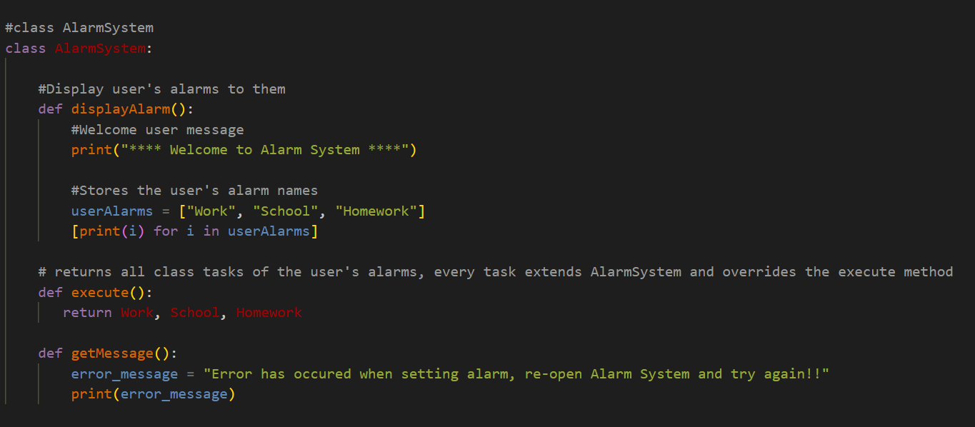
Code
The main class for the overall task - Alarm System

Slide 13
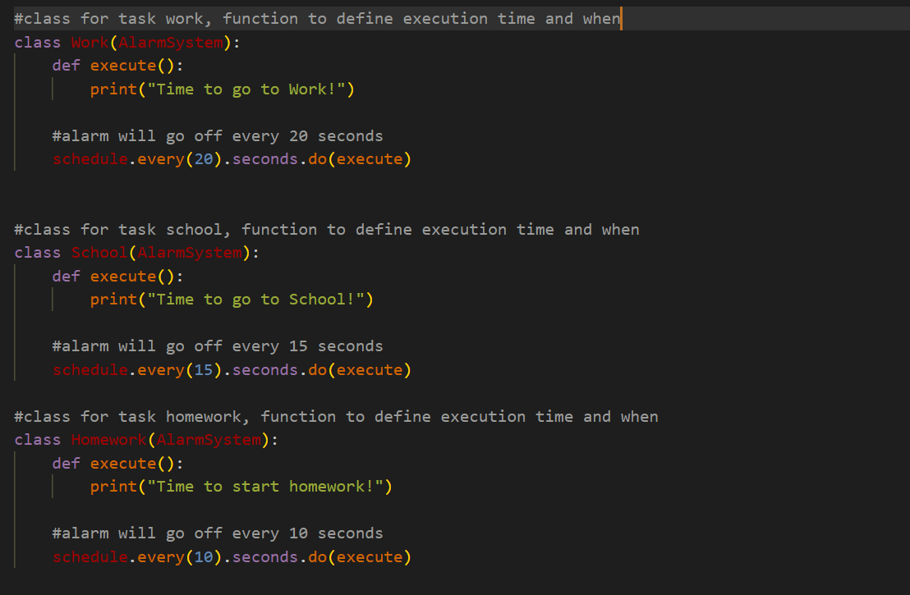
Code
The classes that extend the Alarm System, the alarm tasks Work, School, and Homework

Slide 14
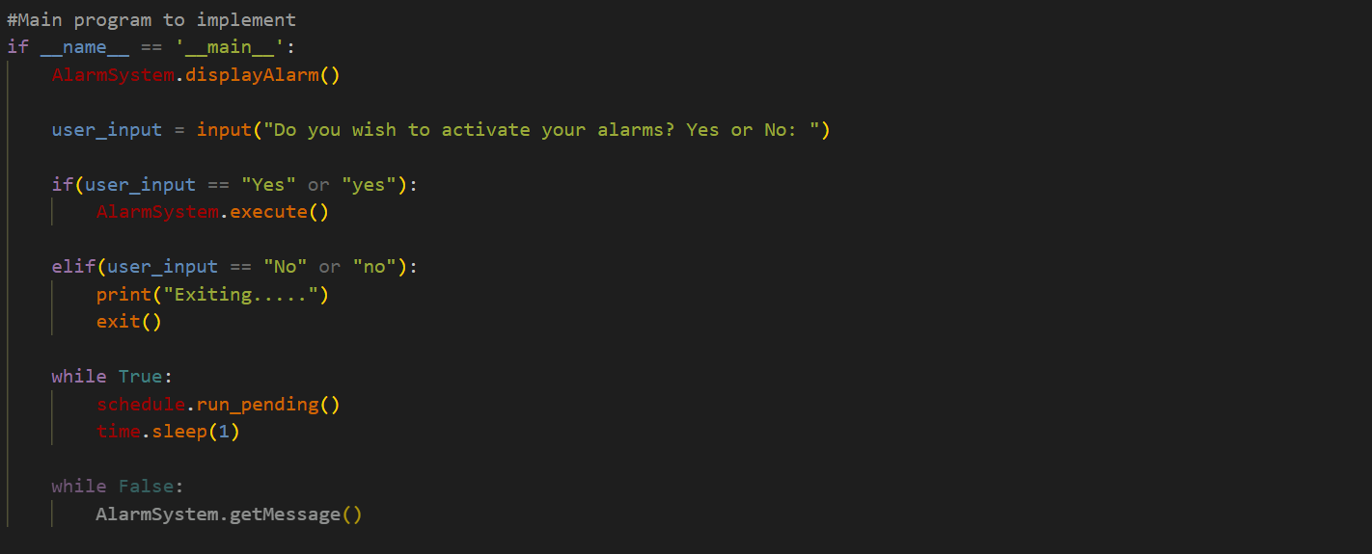
Code
The main function to implement the scheduled task system

Slide 15
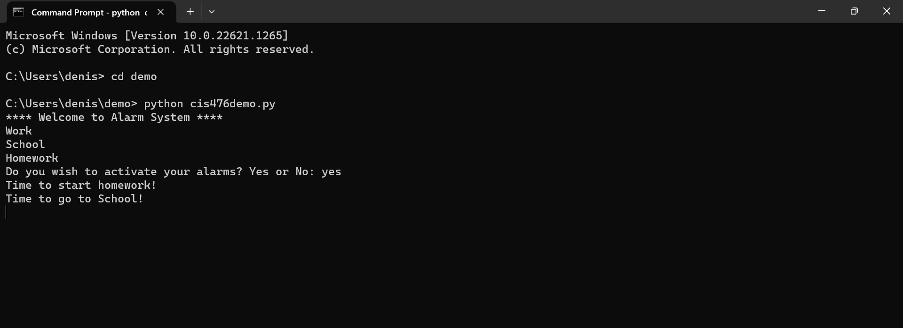
Demo - Output

Slide 16
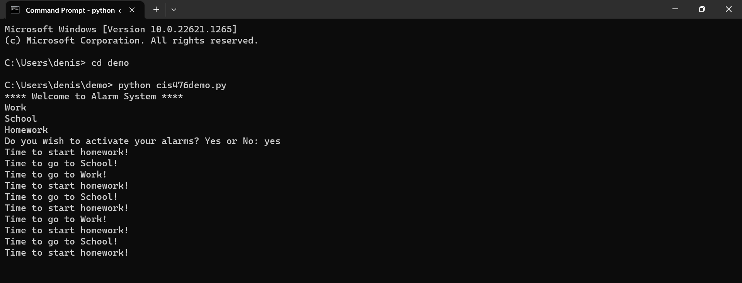
Demo - Output

Slide 17
Resources
http://wiki.c2.com/?ScheduledTask
https://en.wikipedia.org/wiki/Scheduled-task_pattern
https://subscription.packtpub.com/book/application-development/9781785887130/5/ch05lvl1sec61/scheduled-task-pattern
Recorded video link: https://youtu.be/y_vo2WJM_xk
https://www.developerdotstar.com/mag/articles/troche_taskpattern.html
https://www.geeksforgeeks.org/how-to-schedule-python-scripts-as-cron-jobs-with-crontab/?ref=rp
https://www.geeksforgeeks.org/python-schedule-library/

